Slide 1
Modeling the Motion of Fungus Gnat Larvae
Tzu-Chi Yen & Kristen Schneider
Apr. 24, 2019

Slide 2
Notes:
https://www.planetnatural.com/pest-problem-solver/houseplant-pests/fungus-gnat-control/
Larvae: ¼ inch in length, shiny black head, elongated body that Is wither white or transparent. Abundant in damp, rich soils, and feed on organic matter (e.g. grass, fungus, mulch, mold, plant roots, etc.). Full lifespan == 3-4 weeks, but larvae have a 2 week life span, chew on plant roots.

Slide 3
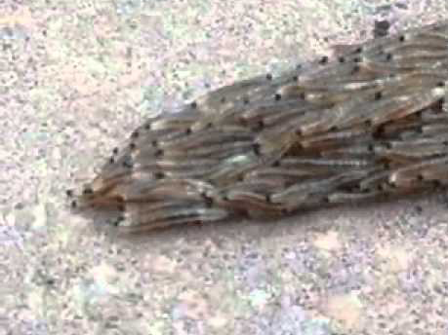
[https://www.dailymail.co.uk/sciencetech/article-2737816/Snakes- No-writhing-mass-hundreds-fungus-gnat-LARVAE-searching-shelter.html]
Notes:
Original video:
Large mass of fungus gnat larvae moving as a collective unit
With some split

Slide 4
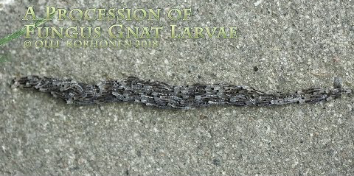
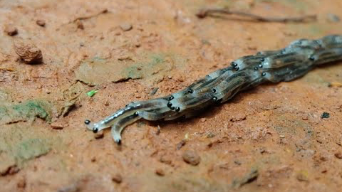
[https://www.youtube.com/watch?v=TU2Q8kVs0hU]
[https://www.youtube.com/watch?v=6MwYvLaJ6Ho]
Notes:
Other videos (more clear)
Leap frog motion seems to be more of a function of weight than a conscious decision…
The split doesn’t really happen in these videos, (starts in the top and then comes back together)
Travel in packs to look more like a snake so that birds don’t attack/eat them

Slide 5
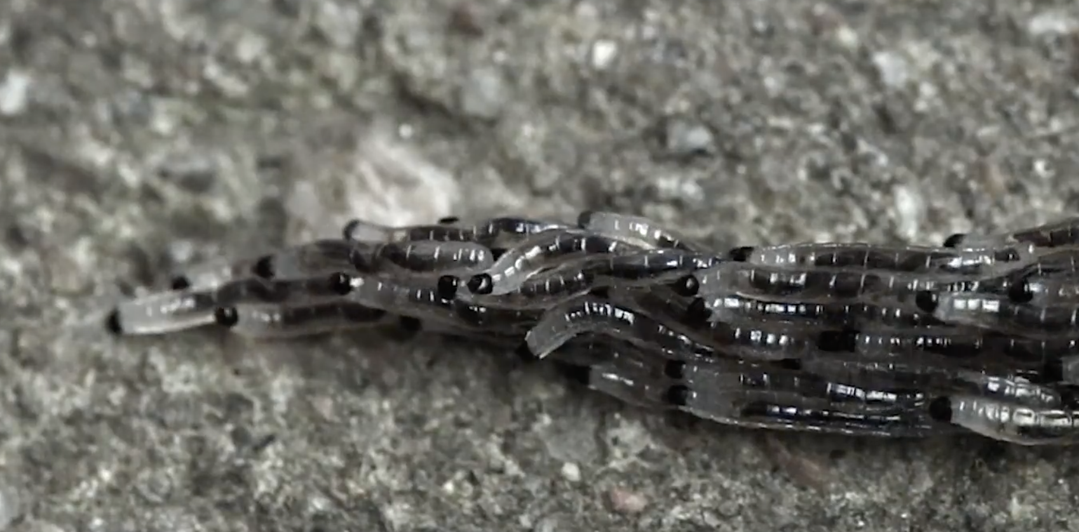
WHY?
STACKED CRAWLING
Appear bigger/more solid to predators (e.g. birds).
Protect certain agents in the middle.
Transportation of some item (e.g. food).
HOW?
Individual forward movement influenced by:
Depth (weight)
Uniform directionality (pre-split) influenced by:
closest neighbors
moisture

Slide 6
WHY?
SPLITTING
Moisture
Weight threshold
HOW?
Front individual(s) become informed
Moisture content
Weight

Slide 7
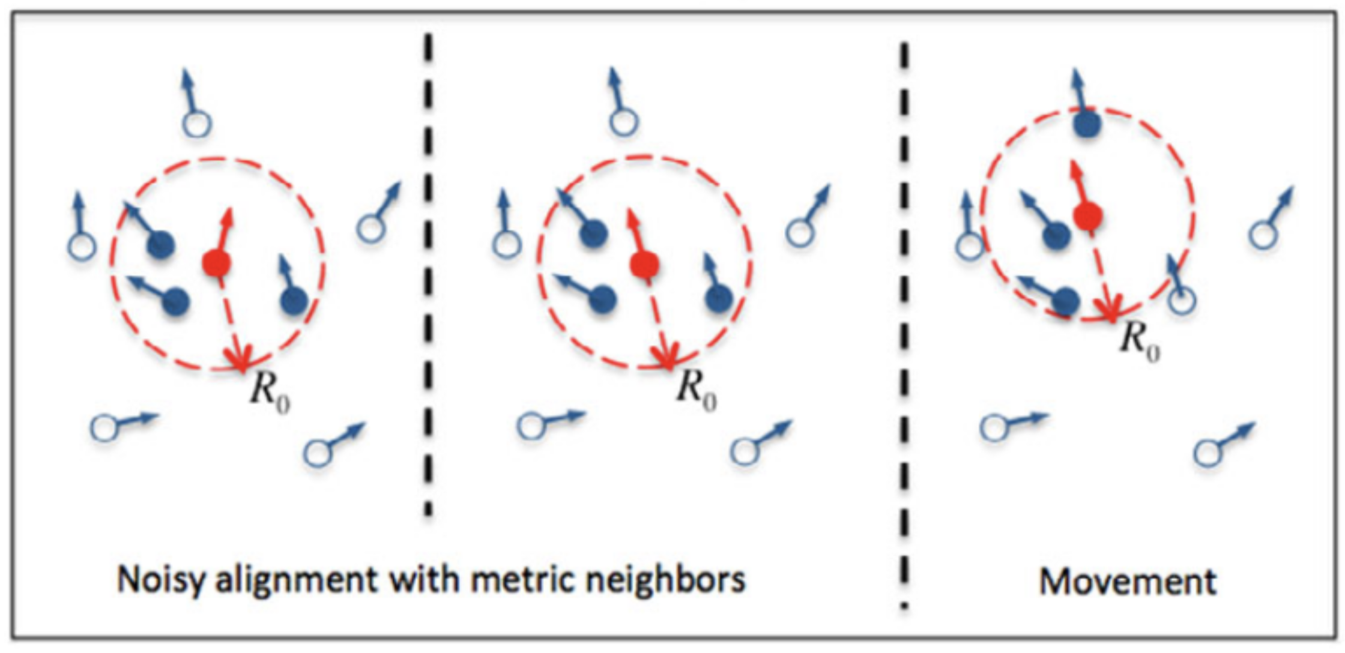
The Vicsek Model (1995)
Rotational symmetry (no transport)
Kinetic phase transition
(by increasing agents)
Collective motion (finite net transport)
Example: https://97amarnathk.github.io/VicsekModel/

Slide 8
Searching for a minimum model that reproduce the behavior …
 | Vicsek Model | Yen-Schneider model
Dimension | 2D | 2D (pseudo 3D)
Depth | -/- | Binary (0 or 1); higher in pile, higher angular noise
Initial agents distribution | Uniform (sparse; average mutual distance > R₀) | Uniform within an ellipse (dense; average mutual distance ~ R₀)
Sensible radius (R₀) | Isotropic | Anisotropic (anterior or posterior)
Velocity | Constant | Constant or 0
Angular noise | Isotropic | Anisotropic

Slide 9
TAIL
HEAD
FRONT
DIRECTION
RADIUS
BACK
AGENT POSITION

Slide 10
Future Work
Splitting behavior
Multiple Layers
Notes:
Changing parameters to see how behaviors change

Slide 11
Acknowledgments
Dr. Orit Peleg (CU Boulder & BioFrontiers Institute)
Code: Alexandra Signoriello (Yale), whose vicsek_model repository on GitHub inspires the design pattern of this project.
Video/News: UK DailyMail online, Snakes? No, this writhing mass is made from hundreds of fungus gnat LARVAE searching for shelter

Slide 12
FRONT
DIRECTION
RADIUS
BACK

